Slide 1
English
Grade III
Sreenithi.S

Slide 2
Collective nouns
A collective noun is a naming word used to refer to a group or number of animals, people or things.

Slide 3
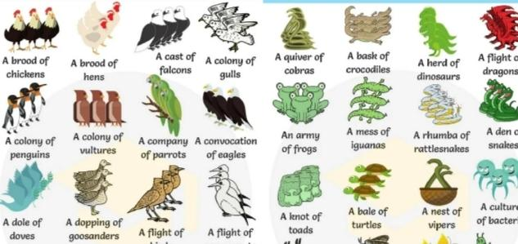

Slide 4
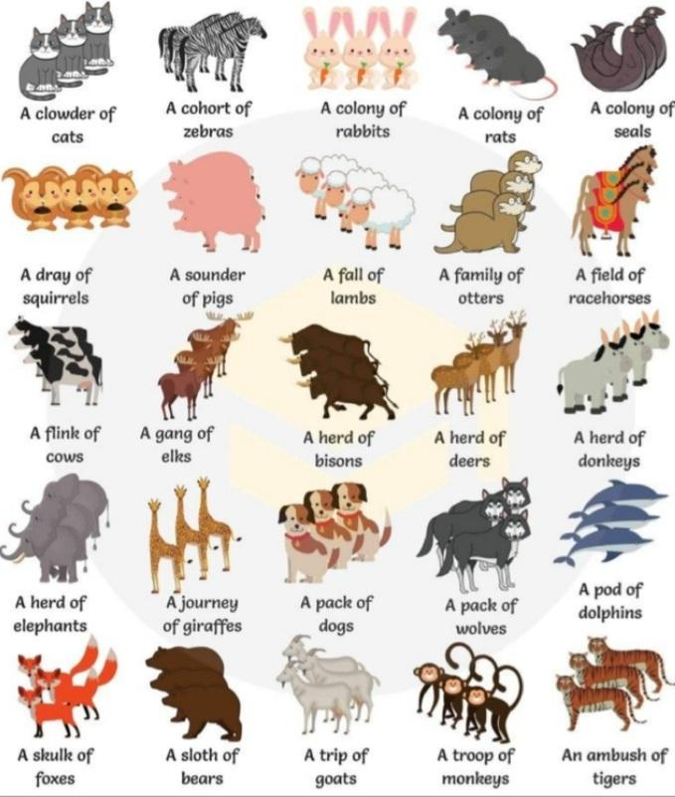
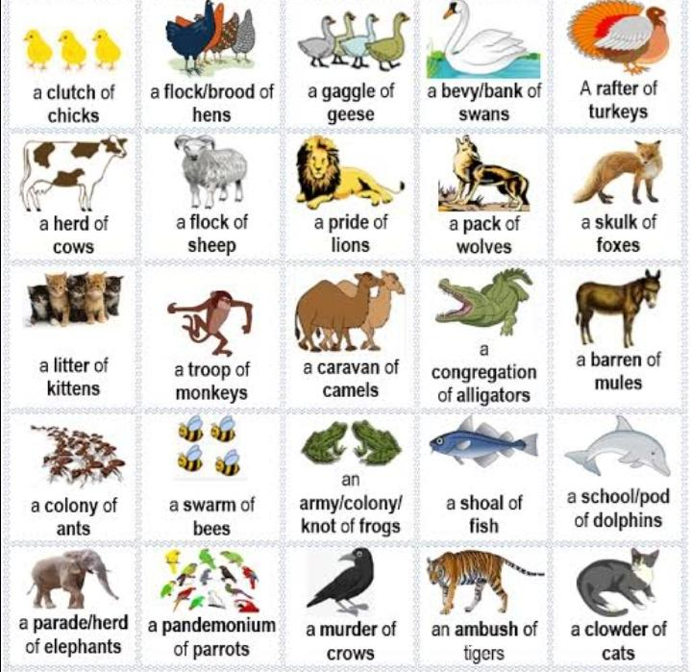

Slide 5
Thank you

